Slide 1


Customizing and extending ArcGIS Web App Templates
Kelly Hutchins @kellyhutchins
Matt Driscoll @driskull

Slide 2

Application Boilerplate JS
Notes:
ArcGIS Boilerplate
And making customizable templates or applications

Slide 3

Templates
(Configurable Apps)
Applications
(Specific Use)
Notes:
Templates are just configurable applications
So, you likely can make an application using the JavaScript API.
We have samples on our site, you can browse the API and write some code to get going.
How do you make a customized template though?

Slide 4





What is it?
Starter Application
Template & app logic
Working with ArcGIS Online
Webmaps
Services
i18n
Authentication
Configurable
Notes:
Most mapping apps have some common functionality
Theres a common workflow for apps to get ArcGIS Online information
They consume similar services
They work with webmaps
Might be localized.
If so, sets you up to make your app work in different languages.
May need to authenticate to ArcGIS Online, Portal or Services
If so, provides helper functions for things like oAuth
May be configurable
You can enable your app to be customized from AGOL by users
A way to organize your code
Most of our templates are based on this boilerplate of code which we have available on GitHub

Slide 5

Customizing the Boilerplate
Layers
Widgets
Panels
Legend
…Whatever
Notes:
With the boilerplate, we start you out with a basic webmap.
What you do with that up to you and what you want your app to accomplish
We’ll walk through some examples of things in a few minutes
If you download one of the online templates, its most likely using this boilerplate and adds on top of it
Things like widgets, UI panels, and things to help achieve it’s purpose

Slide 6
What Do I Get?
Defaults
Localization (Optional)
Web Map, Group, Group Items
Organization Settings (Optional)
Configured Application (Optional)
URL Parameters (Optional)
?webmap=<webmap>
?appid=<id>
Geocoders, print tasks, geometry services
Theme, proxy, custom settings for your app
Notes:
General app structure for large or small apps
Get common application logic
Querying AGOL data

Slide 7
Fetching/Setting up Resources
Items
Authentication
Dependencies
I18n
Application Values
Create Portal
Org Settings
Webmap Item
Group Info
Group Items
Initialize
Proxy
Host URL
Finish Up
Geometry Service
Application Extent
Signed-in status
Notes:
Sets up proxy and your portal URL

Slide 8
Mixing-in Layers of Data
Organization
Settings
URL Parameters
Application
Configuration
Default
Configuration
Localization
Group Info
Group Items
Webmap Item
Notes:
Default application settings via a config file
Query AGOL or portal for org settings
Query for a configured application template if applicable
Any url params that may exist like webmap= or application id. This can be extended to anything

Slide 9

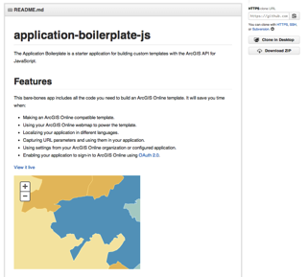

Show me the way
esriurl.com/boilerplate

Slide 10

Demo
Notes:
Alright, let’s see the demo and code
Demo boilerplate code

Slide 11
Create a Configurable Template

Slide 12
Demo
Notes:
So I’m going to demo a configurable app sample

Slide 13
?

